Slide 1
The research process: theoretical framework and hypothesis development
CHAPTER 4

Slide 2
Chapter Objectives
Identify and label variables associated with any given situation.
Establish the links among the variables and evolve a theoretical framework.
Develop a set of hypotheses to be tested and state them in the null and the alternate.
Apply what has been learned to a research project.

Slide 3
Steps 4 and 5
Step 4: Theoretical Framework
Step 5: Generation Hypothesis
(see the next Figure)

Slide 4
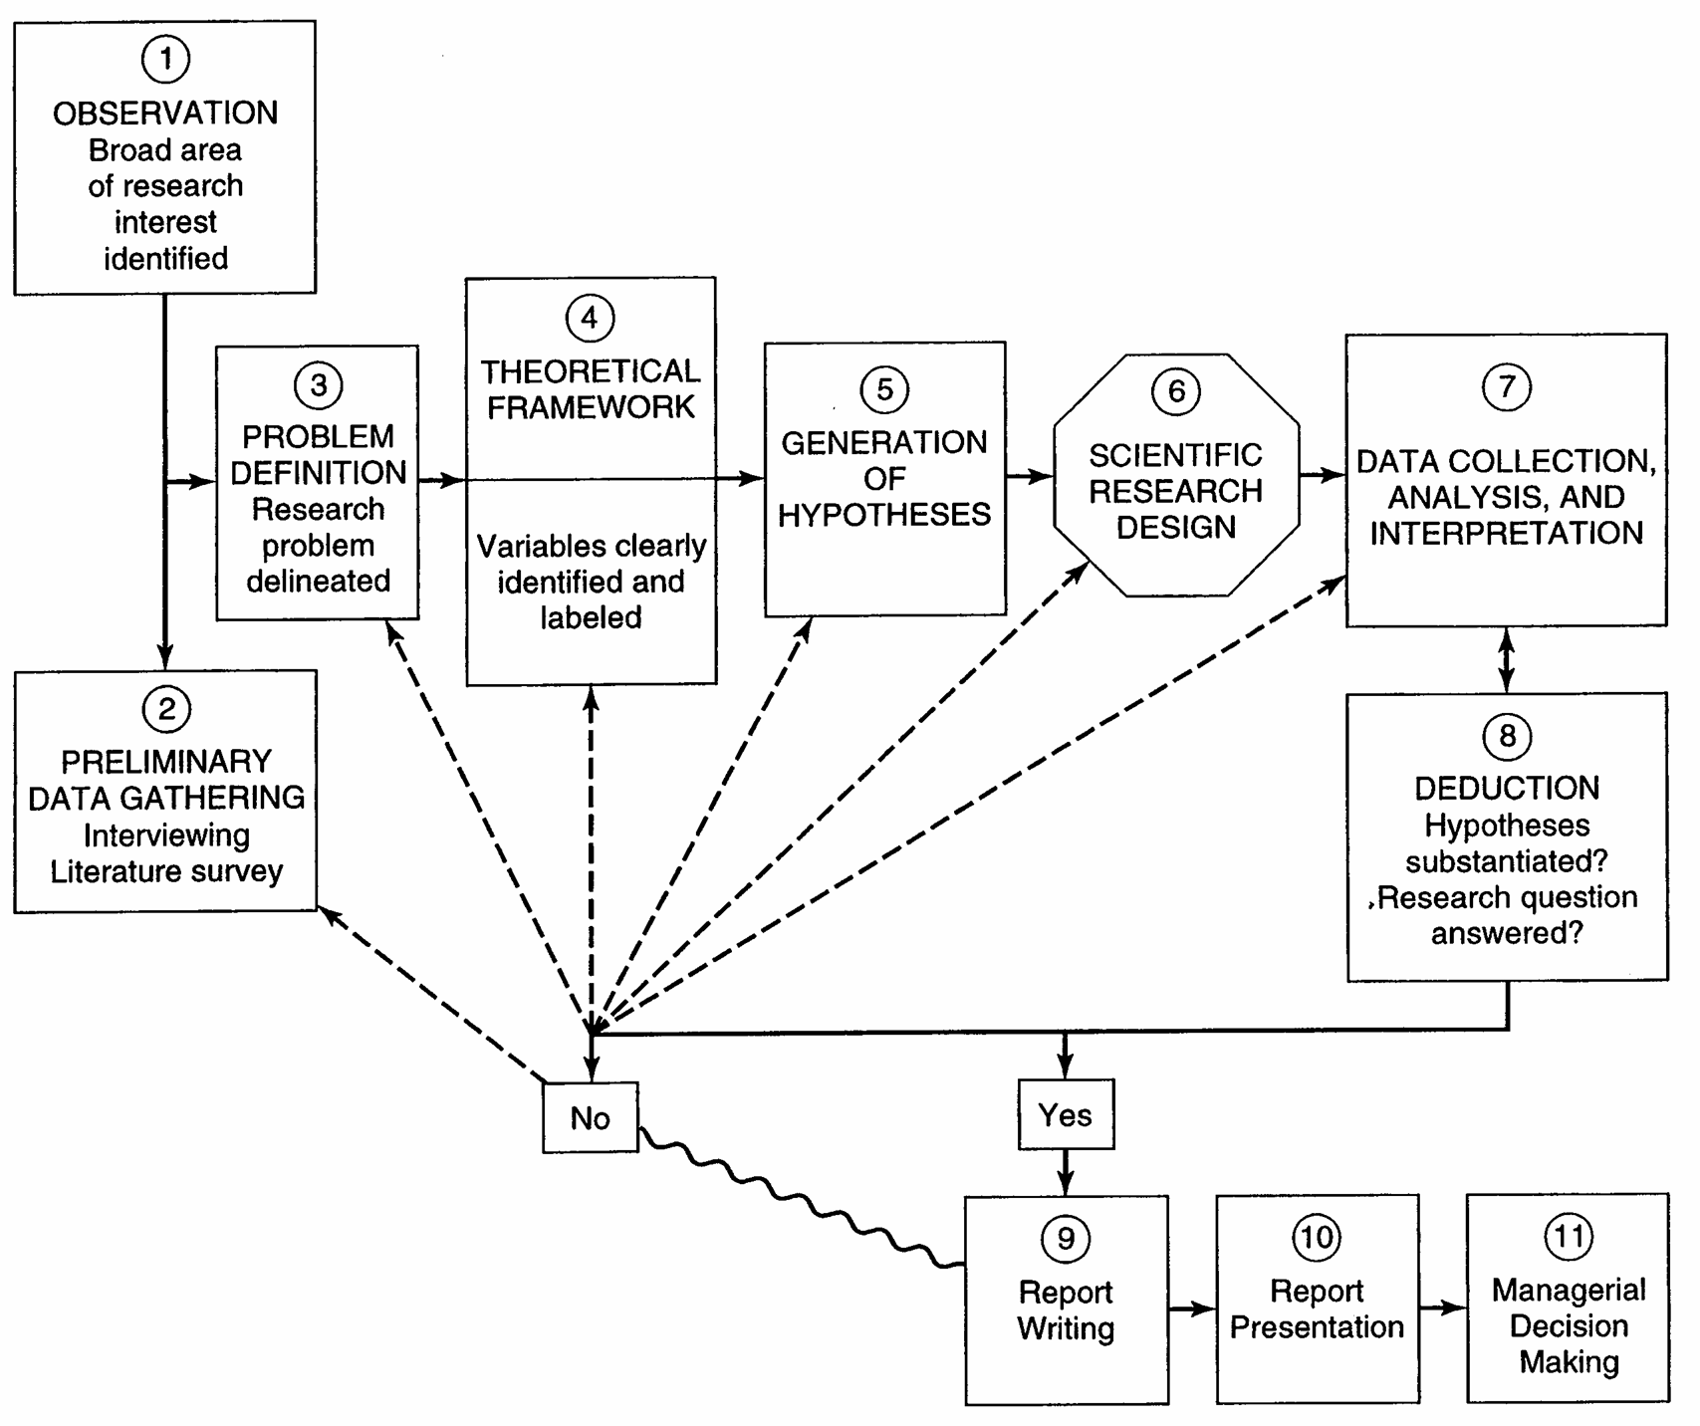
The Steps for Research process

Slide 5
Theoretical Framework
A theoretical framework represents your beliefs on how certain phenomena (or variables or concepts) are related to each other (a model) and an explanation on why you believe that these variables are associated to each other (a theory).

Slide 6
Theoretical Framework
Basic steps:
Identify and label the variables correctly
State the relationships among the variables: formulate hypotheses
Explain how or why you expect these relationships

Slide 7
Variables
Any concept or construct that varies or changes in value
Main types of variables:
Dependent variable
Independent variable
Moderating variable
Mediating variable (or intervening)

Slide 8
(In)dependent Variables
Dependent variable (DV)
Is of primary interest to the researcher. The goal of the research project is to understand, predict or explain the variability of this variable.
Independent variable (IV)
Influences the DV in either positive or negative way. The variance in the DV is accounted for by the IV.

Slide 9
Examples
List the variables, and label them as dependent or independent, explaining why they are so labeled.
Example 1
An applied researcher wants to increase the performance of organizational members in particular bank.

Slide 10
Answer to Example 1
The dependent variable is organizational performance because it is the primary variable of interest to the applied researcher, who wants to increase the commitment of the members in the bank.

Slide 11
Example 2
A marketing manager wonders why the recent advertisement strategy does not work. What would be the dependent variable here?
Answer: The dependent variable is advertisement strategy because the marketing manager is interested in knowing why the recent strategy does not work.

Slide 12
Example 3
Research studies indicate that successful new product development has an influence on the stock market price of the company. That is, the more successful the new product turns out to be, the higher will be the stock market price of the firm.

Slide 13
Answer to the Example 3
Independent Variable is the success of the new product.
Dependent Variable is the stock market price.

Slide 14
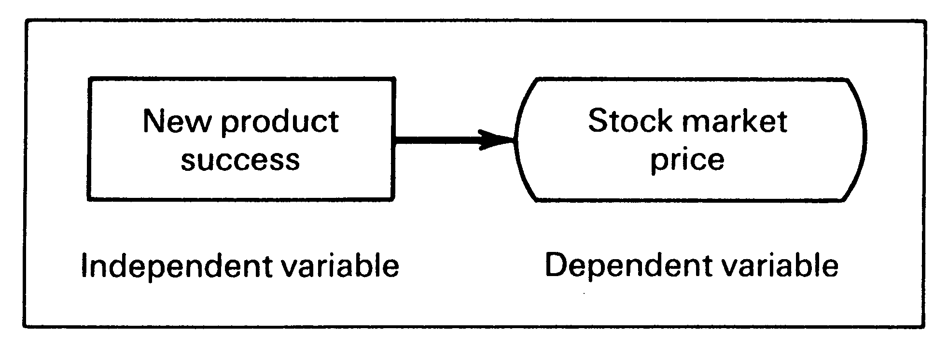

Slide 15
Example 4
Cross-cultural research indicates that managerial values govern the power distance between superiors and subordinates.
Dependent V. : the power distance.
Independent V. : Managerial values.

Slide 16
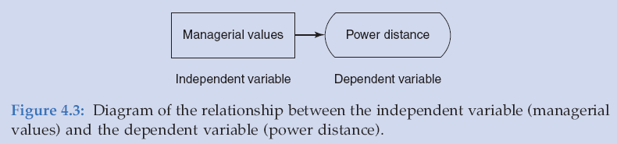

Slide 17
Example 5
A manager believes that good supervision and training would increase the production level of the workers.
Answer
Dependent V.: Production ( Main variable of interest)
Independent V.: Supervision and Training ( Help to explain the variance in production)

Slide 18
Example 6
A consultant is of the opinion that much benefit would accrue by buying and selling at the appropriate times in a financial environment where the stocks are volatile.
Answer
Dependent V.: Gains (variable of primary interest).
Independent V.: Buying at right time and Selling at right time (Explain the variance in gains or benefit).

Slide 19
Example 7
It has been found that there is a relationship between the availability of Reference Manuals that manufacturing employees have access to, and the product rejects. That is, when workers follow the procedures laid down in the manual, they are able to manufacture products that are flawless.

Slide 20
Answer to Example 7
Dependent Variable: number of Rejects.
Independent Variable: Availability of Reference Manuals.

Slide 21
Figure 3a

Slide 22
Example 7 (Cont.)
Although this relationship is true in general for all workers, but it is not true for workers who are not using the manual every time they need it.
Thus, the interest and inclination of the workers is a Moderating Variable.
( See Figure 3B)

Slide 23
Figure 3B

Slide 24
Moderators
Moderating variable
Moderator is qualitative (e.g., gender, race, class) or quantitative (e.g., level of reward) variable that affects the direction and/or strength of relation between independent and dependent variable.
24

Slide 25
The Moderating Variable
Is one that has a strong contingent effect on the independent variable-dependent variable relationship.
The presence of the moderating variable modifies the original relationship between the independent and dependent variables.

Slide 26
Example 8
A prevalent theory is that the diversity of the workforce (according to different ethnic origins, races, and nationalities) contributes more to organizational effectiveness because each group brings it own special expertise and skills to the workplace. This synergy can be exploited, however, only if managers know how to harness the special talents of the diverse work group; otherwise, they will remain untapped.
(See Figure 4)

Slide 27
Figure 4

Slide 28
Distinction Between Variables
Situation 1:
A research study indicates that the better the quality of the training programs in an organization and the greater the growth needs of the employees ( where the need to develop and grow on the job is strong), the greater is their willingness to learn new ways of doing things.

Slide 29
The dependent variable: the employees willingness to learn.
The independent variables: the training programs and growth need strength.
( See Figure 5A)

Slide 30
Figure 5A

Slide 31
Situation 2
Another research study indicates that the willingness of the employees to learn new ways of doing things is not influenced by the quality of the training programs offered by the organizations to all people without any distinction. Only those with high growth needs seem to have the yearning to learn to do new things through specialized training.

Slide 32
The dependent variable in this case is the employees willingness to learn.
The independent variable is the quality of the training program.
The moderating variable is the growth need strength( only those with high growth needs show a greater willingness and adaptability to learn to do new things when the quality of the training programs is improved.
(See Figure 5B)

Slide 33
Figure 5B

Slide 34
The Intervening Variable
Is one that surfaces between the time the independent variables start operating to influence the dependent variable and the time their impact is felt on it.

Slide 35
Example 9
In Example 8 where:
A prevalent theory is that the diversity of the workforce (according to different ethnic origins, races, and nationalities) contributes more to organizational effectiveness because each group brings it own special expertise and skills to the workplace. This synergy can be exploited, however, only if managers know how to harness the special talents of the diverse work group; otherwise, they will remain untapped.

Slide 36
Example 9 Cont.
The dependent variable: the organizational effectiveness.
The independent variable: the workforce diversity.
The intervening variable that surfaces as a function of the diversity in the workforce is creative synergy.

Slide 37
The Intervening Variable
This creative synergy results from the "diverse" workforce interacting and bringing together their expertise in problem solving.
Note that creative synergy, the intervening variable, surfaces at time t2, as a function of workforce diversity, which was in place at time t1, to bring about organizational effectiveness in time t3. The dynamics of these relationships are illustrated in Figures 6 and 7.

Slide 38
Figure 6

Slide 39
Figure 7

Slide 40
Theoretical Framework
Having examined the different kinds of variables that could operate in a situation and how the relationships among these can be established, it is now possible to see how we can develop the conceptual model or the theoretical framework for our research.

Slide 41
Theoretical Framework
The theoretical framework is the foundation on which the entire research project is based.
It is a logically developed, described, and elaborated network of associations among the variables deemed relevant to the problem situation.

Slide 42
The components of the theoretical framework
The variables considered relevant to the study should be clearly defined.
A conceptual model that describes the relationships between the variables in the model should be given.
A clear explanation of why we expect these relationships to exist.

Slide 43
The Relationship Between the Literature Survey and the Theoretical Framework
The literature survey provides a solid foundation for developing the theoretical framework.
The literature survey identifies the variables that might be important, as determined by previous research findings.

Slide 44
The Relationship Between the Literature Survey and the Theoretical Framework
The theoretical framework elaborates the relationships among the variables, explains the theory underlying these relations, and describes the nature and direction of the relationships.
The theoretical framework provides the logical base for developing testable hypotheses.

Slide 45
Example 10 Delta Airlines
According to the reports, Delta Airlines faced charges of air-safety violations when there were several near collisions in midair, and one accident that resulted in 137 deaths in 1987.
Four important factors that seem to have influenced these are:

Slide 46
Example 10 Delta Airlines
Poor communication among the cockpit crew members.
Poor coordination between ground staff and cockpit crew.
Minimal training given to the cockpit crew.
Management philosophy that encouraged a decentralized structure.
Did these factors indeed contribute to the safety violations?

Slide 47
Theoretical Framework for Example 10
The dependent variable is safety violation, which is the variable of primary interest.
The variance in the safety violation is attempted to be explained by the four independent variables of (1) communication among crew members, (2) communication between ground control and the cockpit crew, (3) training received by the cockpit crew, and (4) decentralization.

Slide 48
Theoretical Framework for Example 10
The less the communication among the crew members themselves, the greater is the probability of air-safety violations since very little information is shared among them.

Slide 49
Theoretical Framework for Example 10
When ground crew fail to give the right information at the right time, misfortunes are bound to occur with aborted flights and collisions.
Coordination between ground and cockpit crew is at the very heart of air safety. Thus, the less the coordination between ground control and cockpit crew, the greater the possibility of air-safety violations taking place.

Slide 50
Theoretical Framework for Example 10
Both of the above factors are exacerbated by the management philosophy of Delta Airlines, which emphasizes decentralization.
Centralized coordination and control assume great importance when increased flights overall in midair, and with all airlines operating many more flights.
Thus, the greater the degree of decentralization, the greater is the scope for lower levels of communication both among in-flight staff and between ground staff and cockpit crew, and the greater the scope for air-safety violations.

Slide 51
Theoretical Framework for Example 10
When cockpit crew members are not adequately trained, they may not have the requisite knowledge of safety standards or may suffer from an inability to handle emergency situations and avoid collisions.
Thus, poor training also adds to the probability of increased safety violations.
These relationships are diagrammed in Figure 8.

Slide 52
Figure 8

Slide 53
Interjecting an Intervening variable to the model
We may say that lack of adequate training makes the pilots nervous and diffident, and this in turn explains why they are not able to confidently handle situations in midair when many aircraft share the skies.
Nervousness and diffidence are a function of lack of training, and help to explain why inadequate training would result in air-safety hazard.
This scenario can be depicted as in Figure 9

Slide 54
Figure 9

Slide 55
Poor Training as a Moderating Variable
We may change the model by using (poor) training as a moderating variable.
We are theorizing that poor communication, poor coordination, and decentralization are likely to result in air-safety violations only in such cases where the pilot in charge has had inadequate training.
See Figure 10

Slide 56
Figure 10

Slide 57
Theoretical Framework for Example 10
These examples illustrate that the same variable could be independent, intervening, or moderation, depending on how we conceptualize our theoretical model.

Slide 58
Example 11
Define the problem and develop the theoretical framework for the following situation.
The probability of cancer victims successfully recovering under treatment was studied by a medical researcher in a hospital. She found three variables to be important for recovery:

Slide 59
Exercise
Early and correct diagnosis by the doctor.
The nurse’s careful follow-up of the doctor’s instructions.
Peace and quit in the vicinity.

Slide 60
Exercise (Cont.)
In a quiet atmosphere, the patient rested well and recovered sooner. Patients who were admitted in advanced stages of cancer did not respond to treatment even though the doctor’s diagnosis was performed immediately on arrival, the nurses did their best, and there was plenty of peace and quit in the area.

Slide 61
Exercise (Cont.)
Thus, stage of cancer is a moderating variable.
Also, we could use the patient rest as an intervening variable as shown in Figure 11.

Slide 62
Solution to the Exercise

Slide 63
Hypothesis
A proposition that is empirically testable. It is an empirical statement concerned with the relationship among variables.
Good hypothesis:
Must be adequate for its purpose
Must be testable
Must be better than its rivals
Can be:
Directional
Non-directional

Slide 64
Hypotheses Development
Definition of Hypotheses: Is a logical relationship between two or more variables expressed in the form of a testable statement.

Slide 65
Statement of Hypotheses: Formats
If-Them Statements
Can be used to test whether there are differences between two groups. It takes two forms:
(1) Employees who are more healthy will take sick leave less frequently.
(2) If employees are more healthy, them they will take sick leave less frequently.

Slide 66
Directional and Nondirectional Hypotheses
Directional hypotheses: the direction of the relationship between the variables (positive/negative) is indicated.

Slide 67
Example 12
The greater the stress experienced in the job, the lower the job satisfaction of employees.
Or
Women are more motivated than men are.

Slide 68
Nondirectional hypotheses
Nondirectional hypotheses: there are no indication of the direction of the relationships between variables.

Slide 69
Example 13
There is a relationship between age and Job satisfaction.
Or
There is a differences between the work ethic values of American and Arabian employees.

Slide 70
Null and Alternate Hypotheses
The null hypotheses is a proposition that states a definitive, exact relationship between two variables.
It states that the population correlation between two variables is equal to zero (or some definite number).
In general, the null statement is expressed as no (significant) difference between two groups.

Slide 71
The Alternate Hypotheses
The alternate hypotheses is the opposite of the null hypotheses, is a statement expressing a relationship between two variables or indicating differences between groups.

Slide 72
Examples for the Directional Relationships
The null hypotheses: In past example were we state that: Women are more motivated than men are. Then,
H0: µM = µw
Or
H0: µM - µw = 0
Where H0 represents the null hypotheses,
µM is the mean motivational level of the men,
µw is the mean motivational level of women.

Slide 73
The alternate hypotheses for the above example:
HA : µM < µw
Which is the same as
HA : µM > µw
Where HA represents the alternate hypotheses.

Slide 74
Examples for the nondirectional relationship
There is a difference between the work ethic of American and Arabian employees.
The null hypotheses would be:
Ho: µAM = µAR
Or
Ho: µAM - µAR = 0
Where µAM is the mean work ethic value of Americans and µAR is the mean work ethic value of Arabs.

Slide 75
Examples for the nondirectional relationship
The alternate hypotheses for the above example would statistically be set as:
HA: µAM ≠ µAR
where HA represents the alternate hypotheses.

Slide 76
Examples for the nondirectional relationship
For the example: The greater the stress experienced in the job, the lower the job satisfaction of employees.
The null hypotheses would be:
Ho: There is no relationship between stress experienced on the job and the job satisfaction of employees.
This would be statistically expressed by:
Ho: P = 0
where P represents the correlation between
stress and job satisfaction, which in this case is equal to 0 ( no correlation).

Slide 77
Examples for the nondirectional relationship
The alternate hypotheses for the above null, can be stated as:
HA: P<0 (the correlation is negative)

Slide 78
Examples for the nondirectional relationship
For the example: There is a relationship between age and job satisfaction.
For this nondirectional statement, the null hypotheses would be statistically expressed as:
H0: p=0
The alternate hypotheses would be expressed as:
H0: P ≠ 0

Slide 79
Exercise
Give the hypotheses for the following framework:
Service quality
Customer switching
Switching cost
.

Slide 80
Exercise
Give the hypotheses for the following framework:
Service quality
Customer satisfaction
Customer switching

Slide 81
After formulating the null and alternate hypotheses, the appropriate statistical tests (t tests, F tests) can be applied, which would indicate whether or not support has been found for these hypotheses.

Slide 82
Example 14
A production manager is concerned about the low output levels of his employees. The articles that he read of job performance mentioned four variables as important to job performance: skill required for the job, rewards, motivation, and satisfaction. In several articles it was also indicated that only if the rewards were (attractive) did motivation, satisfaction, and job performance increase, not otherwise.

Slide 83
Example 14 (cont.)
Given the above situation, do the following:
1. Define the problem.
2. Evolve a theoretical framework.
3. Develop at least six hypotheses.

Slide 84
Example 14 (cont.)
Problem Statement
How can the job performance (output) of the employees be increased through enriched jobs and rewards?

Slide 85
Schematic Diagram for the Theoretical Framework

Slide 86
Hypotheses for Example 14
HA1: If the job is enriched and utilizes all the skills possessed by the employee, then employee satisfaction will be high.
HA2: If the job is enriched and utilizes all the skills possessed by the employee, then employee motivation will be high.
HA3: There will be a positive correlation between satisfaction and motivation.

Slide 87
Hypotheses for Example 14
HA4: Greater rewards will influence motivation and satisfaction only for those employees who find the rewards attractive, not for the others.
HA5: Satisfaction and motivation will positively influence performance.
HA6: The more enriched the job and the greater the skills utilized by the job, the higher the level of employee performance.

Slide 88
Example of Literature Review, Theoretical Framework, and Hypotheses Development
Introduction
Despite the dramatic increase in the number of managerial women during the current decade, the number of women in top management positions continues to be very small, suggesting a glass ceiling effect that women currently face (Morrison, W. & Vura, 1999; Van Velsor,2000).

Slide 89
Introduction (Cont.)
Given the projected demographics of the workplace, which forecasts that for every six or seven women entering the workforce in the future, there will be about only three males joining the labor market, it becomes important to examine the organizational factors that would facilitate the early advancement of women to top executive positions.

Slide 90
Introduction (Cont.)
This study is an effort to identify the factors that currently impede women’s advancement to the top in organizations.

Slide 91
A Brief Literature Survey & Theoretical Framework
Read the paragraphs about the literature survey and theoretical framework for the above example on page 93 from the textbook.

Slide 92
The Hypotheses
1. The greater the extent of gender stereotyping in organizations, the fewer will be the number of women at the top.
2. Male managers have more access to critical information than women managers in the same rank.
3. There will be a significant positive correlation between access to information and chances for promotion to top-level positions.

Slide 93
The Hypotheses
4. The more the sex-role stereotype, the less the access to critical information for women.
5. Sex-role stereotyping and access to critical information will both significantly explain the variance in promotional opportunities for women to top-level positions.
(See next Figure)

Slide 94
Figure: schematic diagram of the example

Slide 95
Exercises on Theoretical Framework
Develop a theoretical framework for the following situation and state one testable hypothesis in the null and the alternate.
A school administrator is interested in finding how the threatened teachers’ strike can be averted. He knows that pay demands and the classroom’s physical environment are the two main issues in the situation. He, however, feels that these two are not major concerns for the teachers who are extremely dedicated to teaching.

Slide 96
Exercises on Theoretical Framework (Cont.)
Theoretical Framework
Since the administrator’s main concern is about the strike, teachers’ strike is the dependent variable. Pay and the physical environment of the classroom are the two independent variables, which influence the strike situation.

Slide 97
Exercises on Theoretical Framework (Cont.)
The grater the pay demands made by the teachers, the greater the possibility of a strike, since the school administration refuse the idea of higher wages. The more uncomfortable the classroom physical environment, the more difficult it will be for teachers to do an effective job in the classroom, and hence the greater the possibility of teachers going on strike.

Slide 98
Exercises on Theoretical Framework (Cont.)
However, this relationship between the independent variables and the dependent variable will be true only for those teachers who are not dedicated to teaching. The truly dedicated teachers would be more concerned about doing a good job despite the hardships faced by them, and hence the pay demands and the classroom environment will not be factors influencing their decision to join the strike.
(See Schematic Diagram).

Slide 99
Schematic Diagram

Slide 100
Hypothesis:
H01: Dedication to teaching will not alter the relationship between the independent variables of pay and classroom environment and the dependent variable of teachers’ decision to go on strike.

Slide 101
Hypothesis:
HA1: only for those teachers who are not truly dedicated to teaching, will pay considerations and classroom environment be factors that would influence their decision to go on strike.

Slide 102
Exercise
Here are eight variables:
1) Understanding student needs (by teacher);
2) Developing appropriate teaching strategies (by teacher);
3) In-class examples and exercises;
4) Student entry level skills;
5) Student understanding;
6) Student exam performance;
7) Difficulty of exam;
8) Stress.

Slide 103
Exercise
a. With these eight variables, develop a theoretical framework, treating #4 (Student entry level skills) as a moderator, and variable #5 (Student understanding) as an intervening variable.
b. Develop four hypotheses.

Slide 104
ANSWERS
a. The variance in the performance of students in the exam can be accounted for by the four independent variables – teacher’s understanding of the needs of the students, the different teaching strategies developed by the teacher, the number of in-class examples and exercises that the teacher gives, and how difficult the exam itself happens to be.

Slide 105
ANSWERS (Cont.)
When the teacher understands students’ difficulties and needs, he tries to develop appropriate teaching strategies in order to meet the needs of the students to understand what is being taught, students understanding will increase.

Slide 106
ANSWERS (Cont.)
In addition, if the teacher uses several examples to put across the points and gives exercises in class to test the extent to which students have understood , then, the students’ level of understanding of what is being taught will increase. However, the entry- level skills of the students should be sufficiently adequate to enable them to understand what is being taught. If the student entry level skills and comprehension are very low, then the teachers’ efforts will not work.

Slide 107
ANSWERS (Cont.)
The level of difficulty of the exam is also another factor that would account for the variance in student performance. The more difficult the exam, the more stressed the students will feel while answering the exam, and the lower will be their performance level in the exam. Thus, stress is the intervening variable here.
( see next Figure).

Slide 108
Figure: Schematic Diagram on student performance

Slide 109
Hypotheses
HA1: Only for those who have the requisite entry level skills, will more in-class exercises and examples help increase the students’ level of understanding of the subject taught.
HA2: The more difficult the exams, the greater the stress experienced by the students.

Slide 110
Hypotheses
HA3: The higher the level of stress experienced by the students, the lower their level of performance in the exam.
HA4: When students understand the subject better, they will perform better in the exam.

